Slide 1


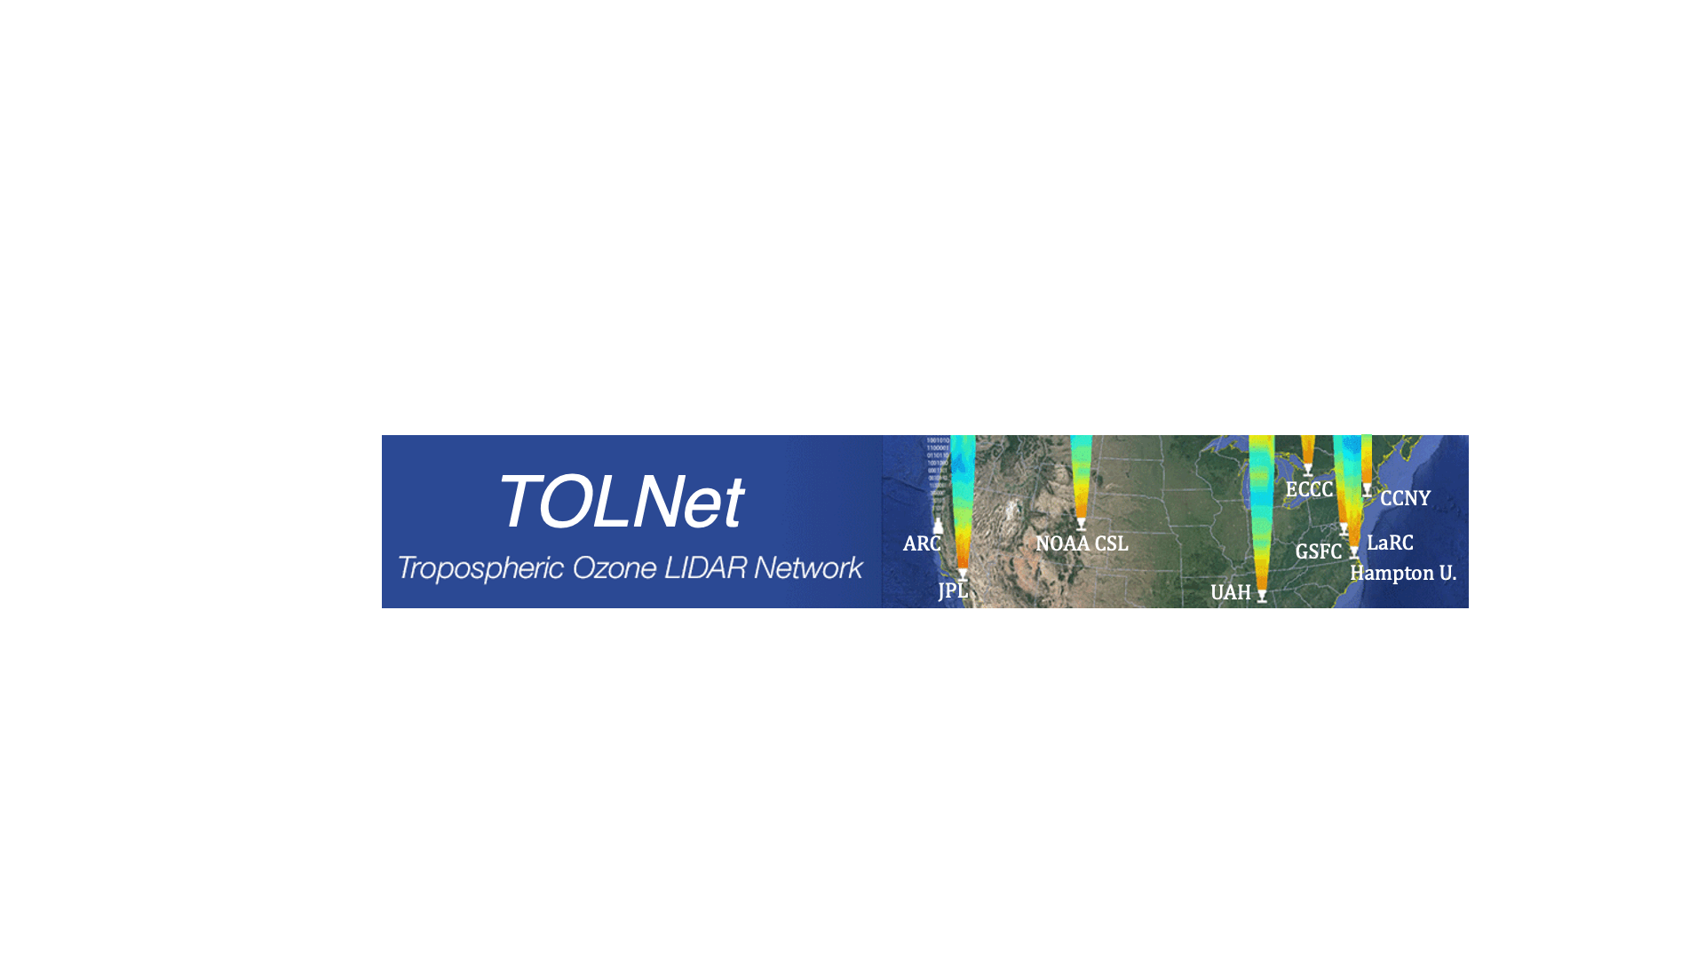

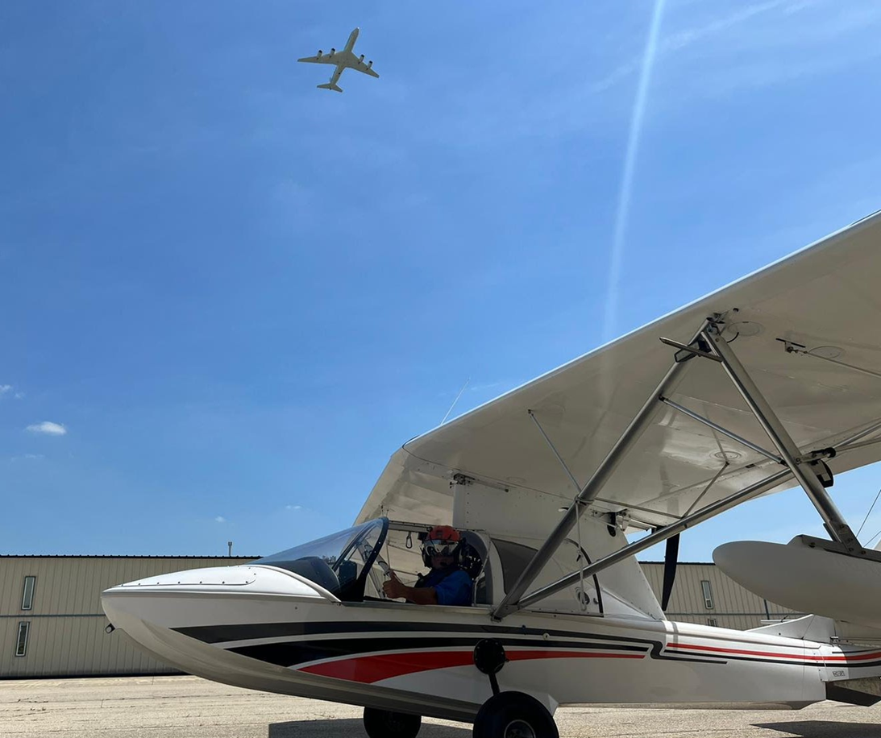
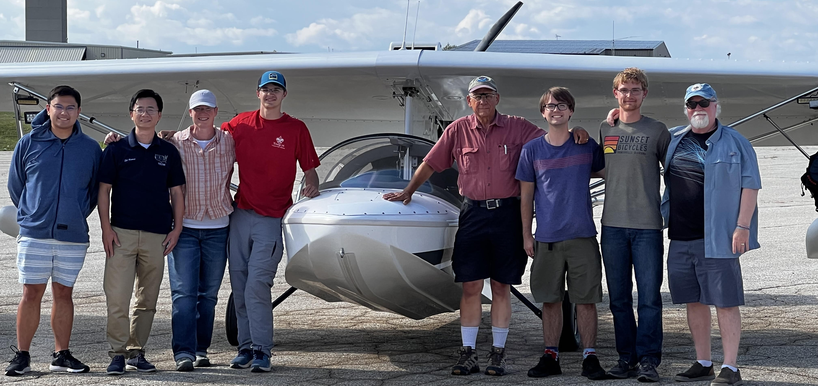
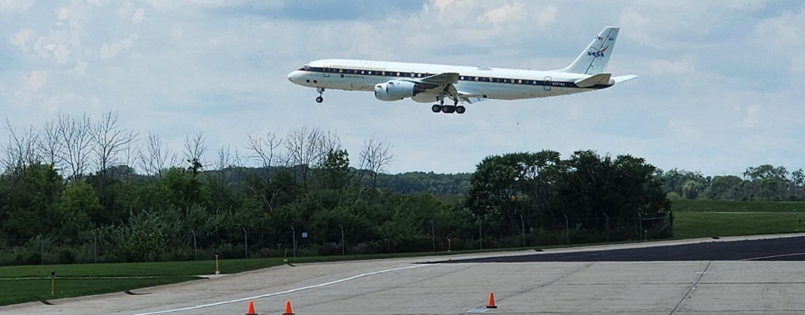
SeaRey mACES and DC-8 ACES NO₂ under TEMPO
Mike Newchurch/UAH, Carrie Womack/CSL, and Brooke Lynn/UAH

Slide 2

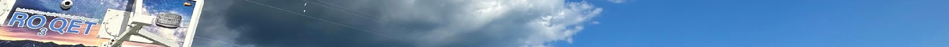
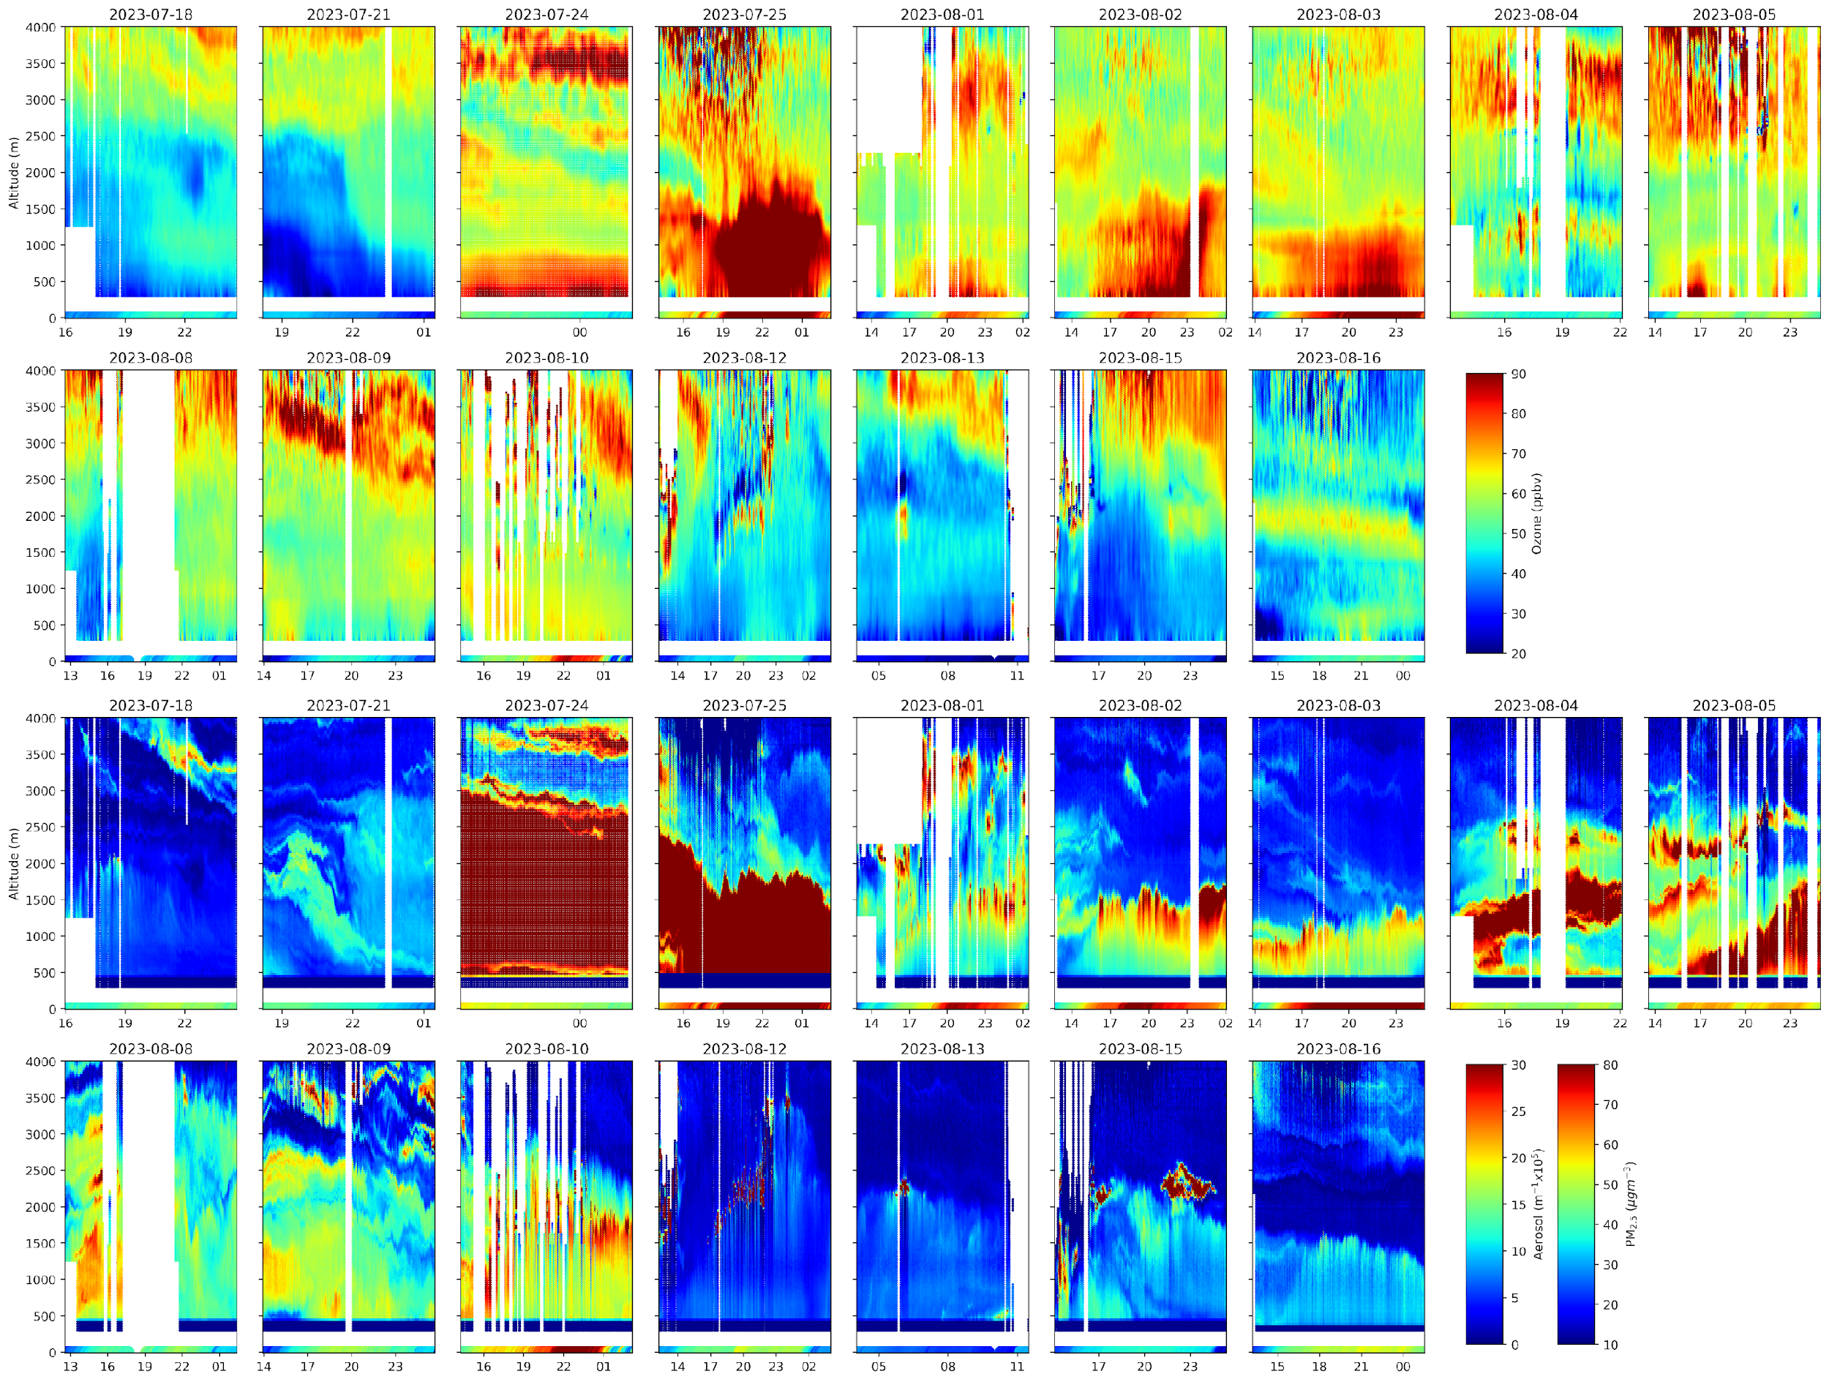
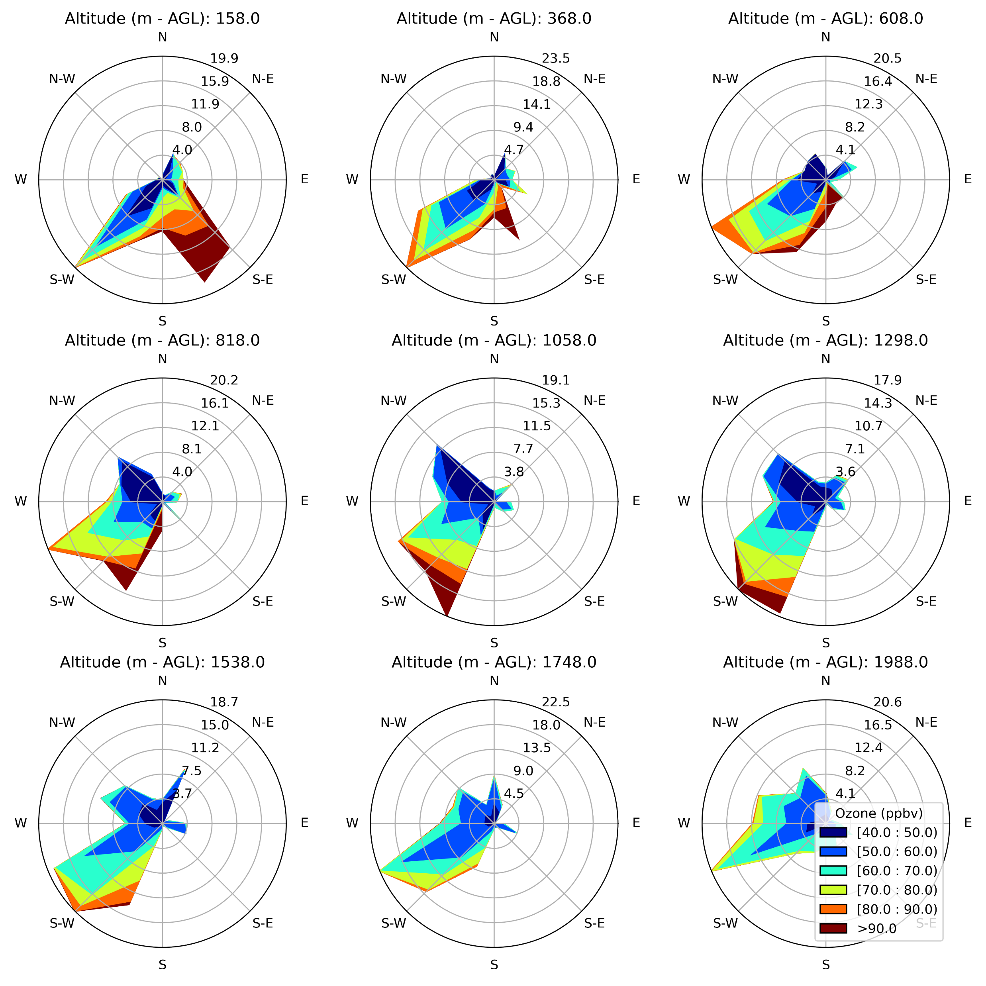






LMBREEZE Measurements: TOLNet Ozone LiDAR (RO3QET)
Ozone
(0 – 4km AGL)
Aerosol
(0 – 4km AGL)
Left: Ozone (top) and Aerosol (bottom) curtains taken during the campaign duration using the TOLNet
LiDAR at Chiwaukee Prairie. Top: Wind roses of ozone retrievals parried with UWisc Dopplar Wind LiDAR at 200 m intervals starting at 158 m AGL.
Validation: Matt Johnson, next talk.
Aug 20, 2025 TEMPO/GeoXO ACX Cambridge, MA

Slide 3
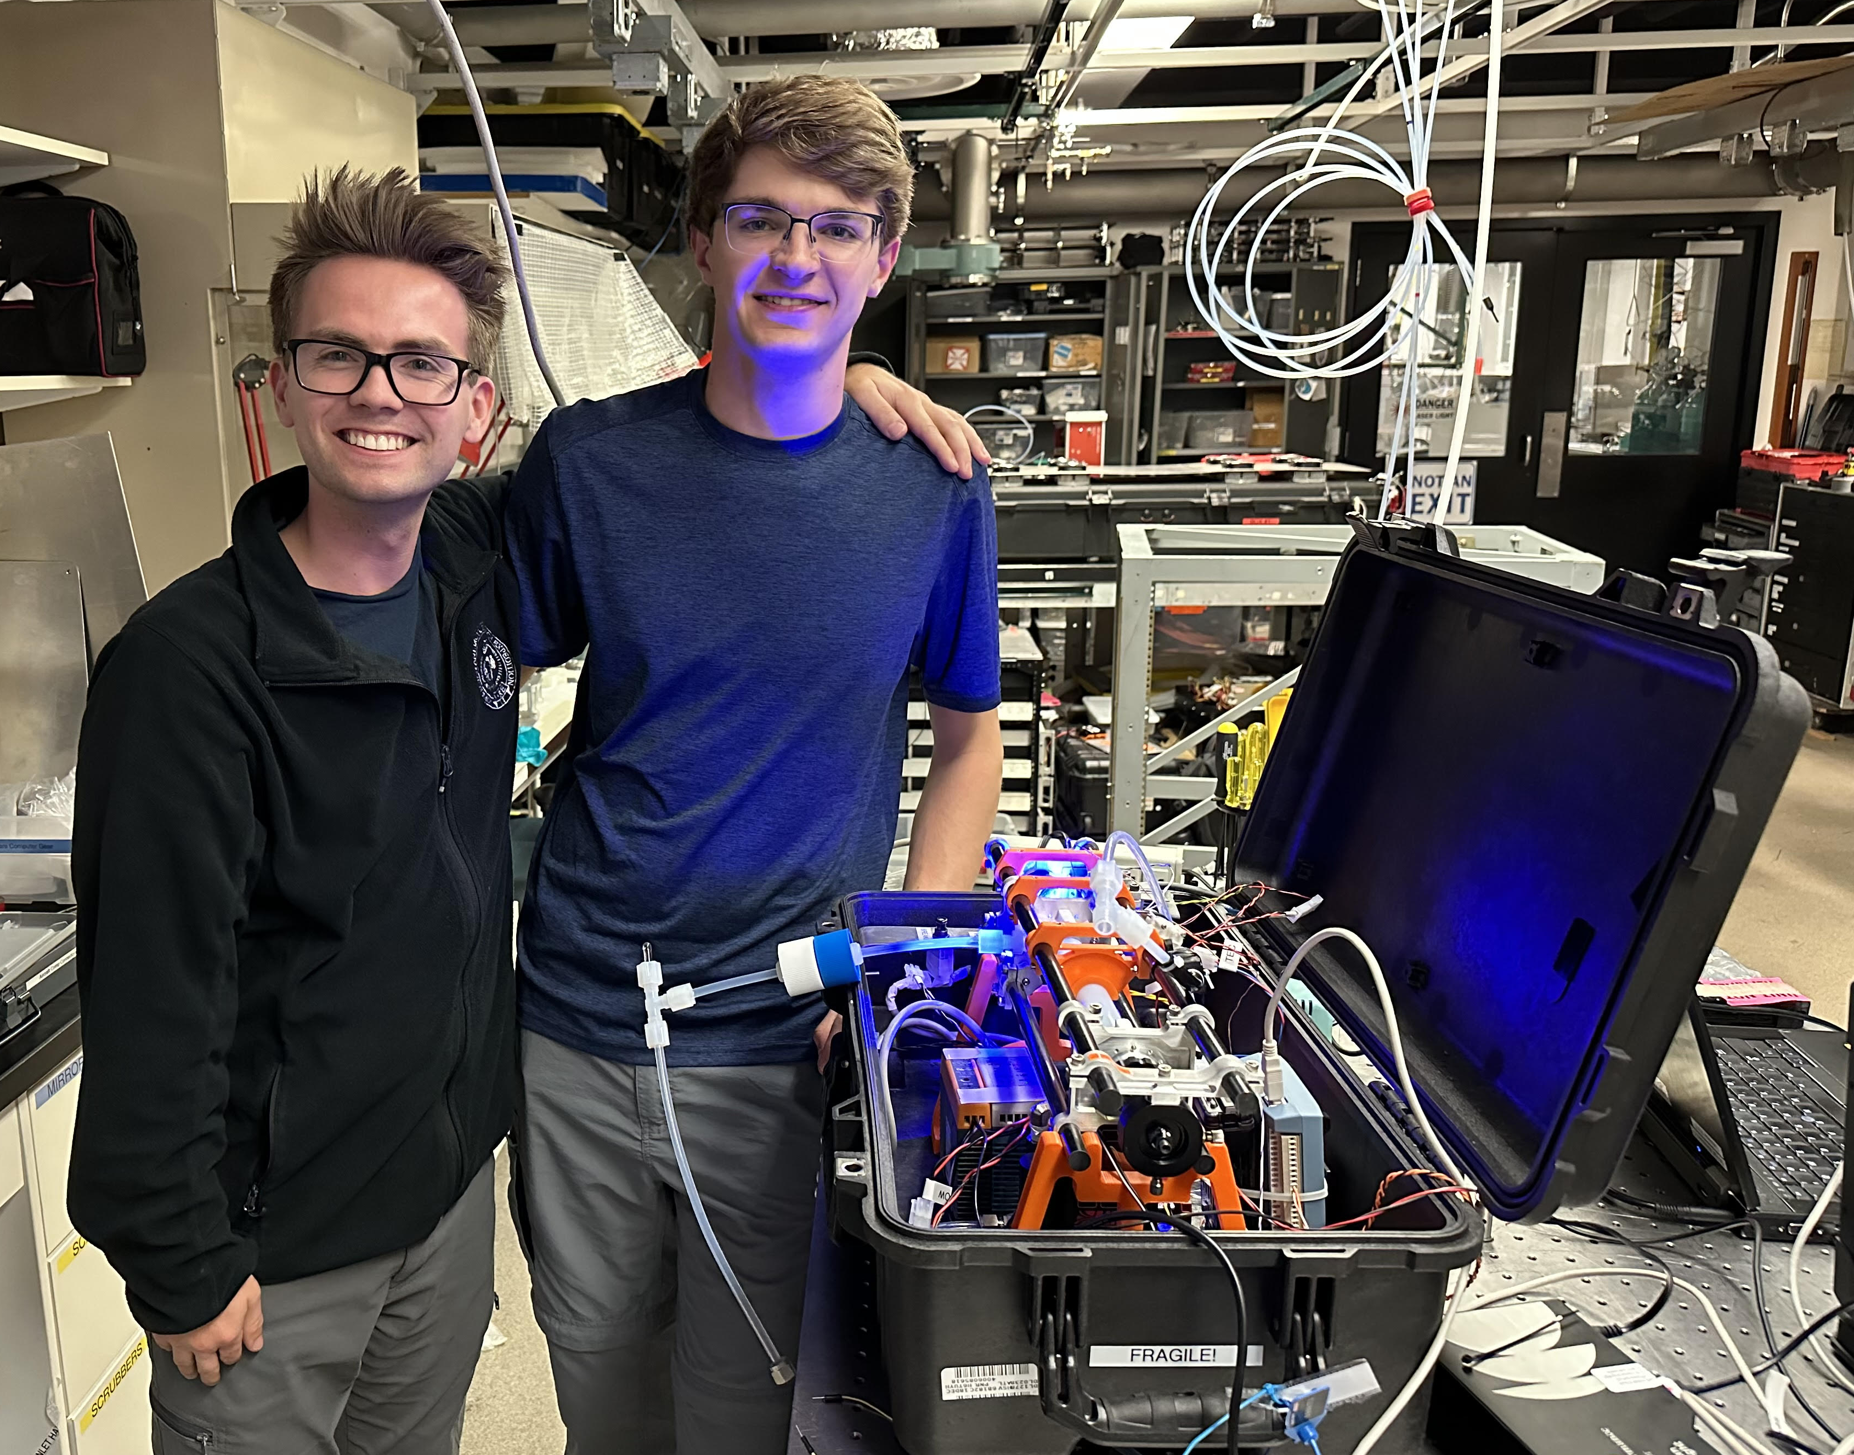
mACES instrument built at NOAA/CSL by Todd McKinney/UAH and Mason Mills/UAH under the guidance of Carrie Womack/CSL in the Steve Brown/CSL Boulder laboratory in the heritage of Dave Fahey/CSL NO₂ airborne instruments.

Slide 4

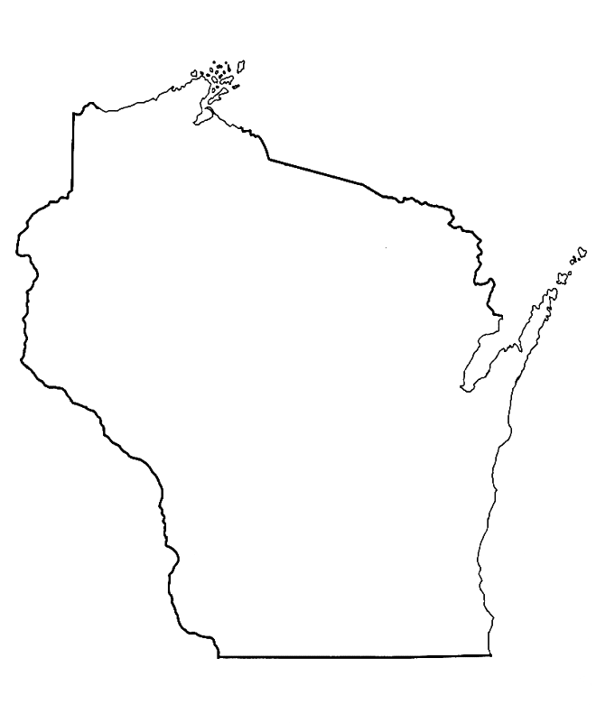
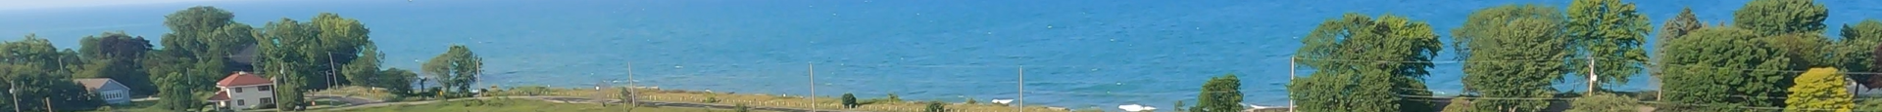




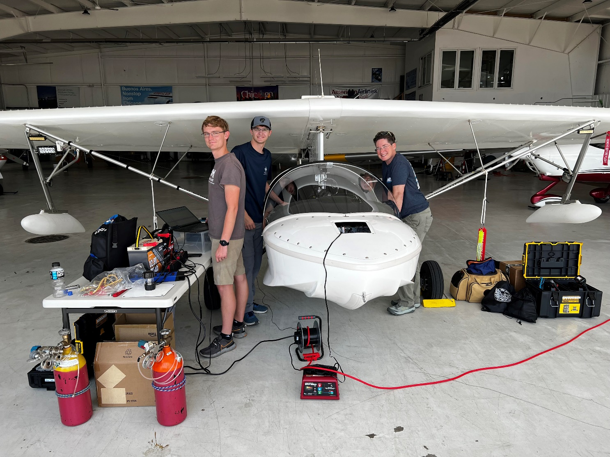
mACES Integration into the SeaRey
Darby Stevenson/UAH, Mason Mills/UAH, and Paula Tucker/UAH integrate the mACES, 2B 205 ozone, and custom PM2.5 aerosol instruments into the Progressive Aerodyne SeaRey aircraft in Hangar 9 at Kenosha, WI.

Slide 5
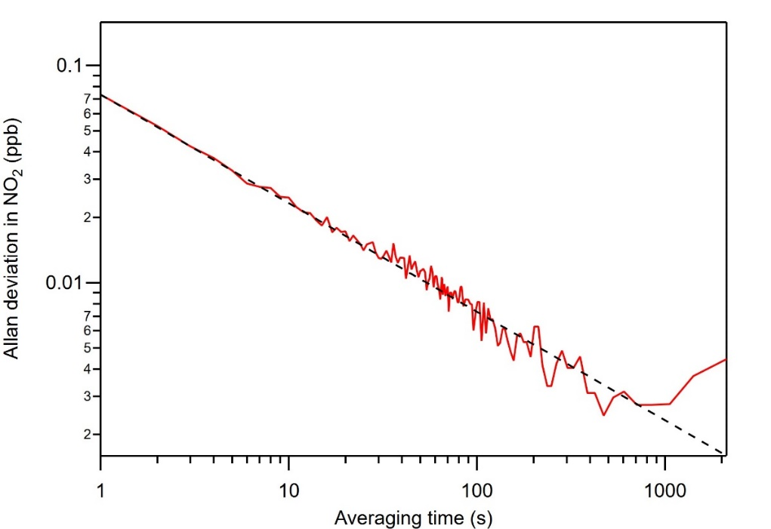
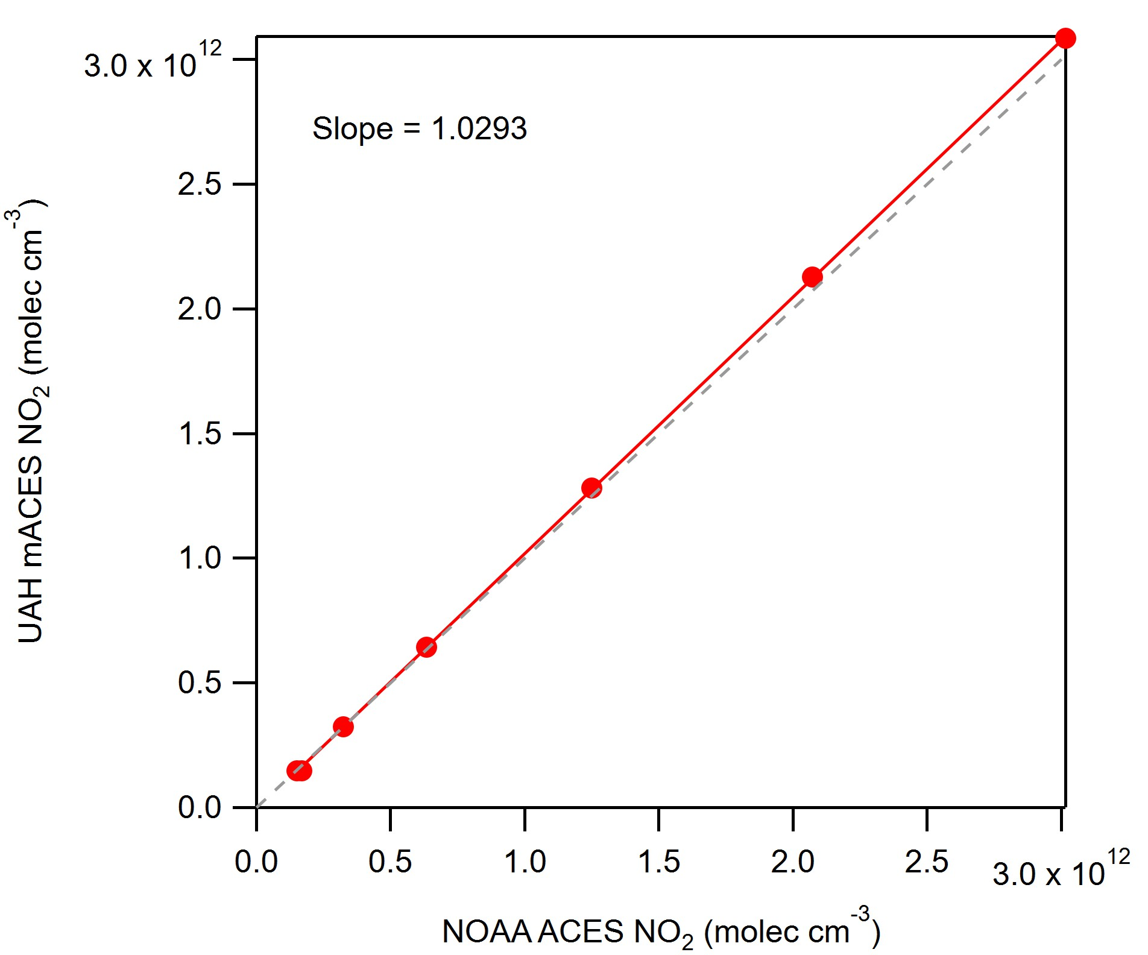
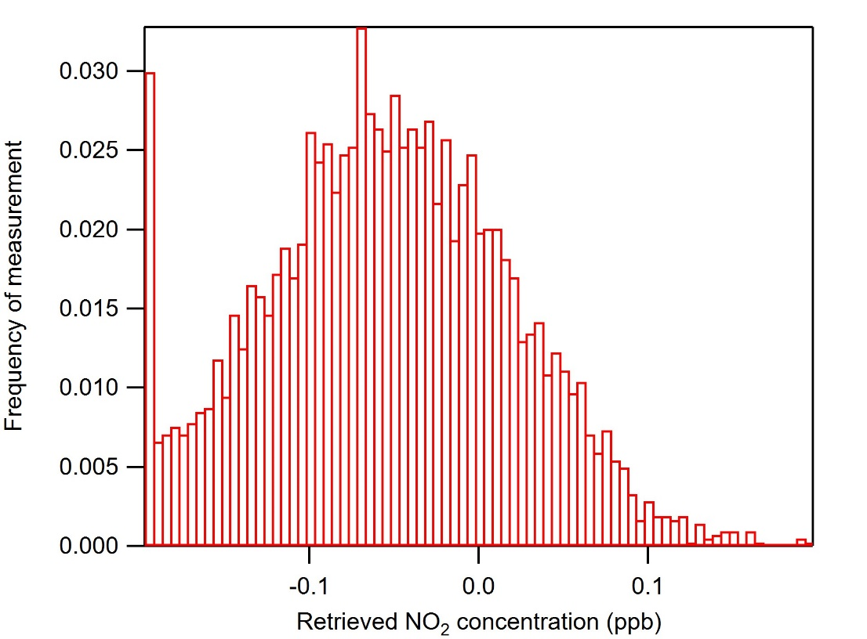
mACES pre-flight calibration
1 Hz precision = 0.073 ppbv (Allan deviation)
Calibration accuracy: mACES is 3% higher than CSL ACES
Zero air distribution = -0.05 ppbv

Slide 6
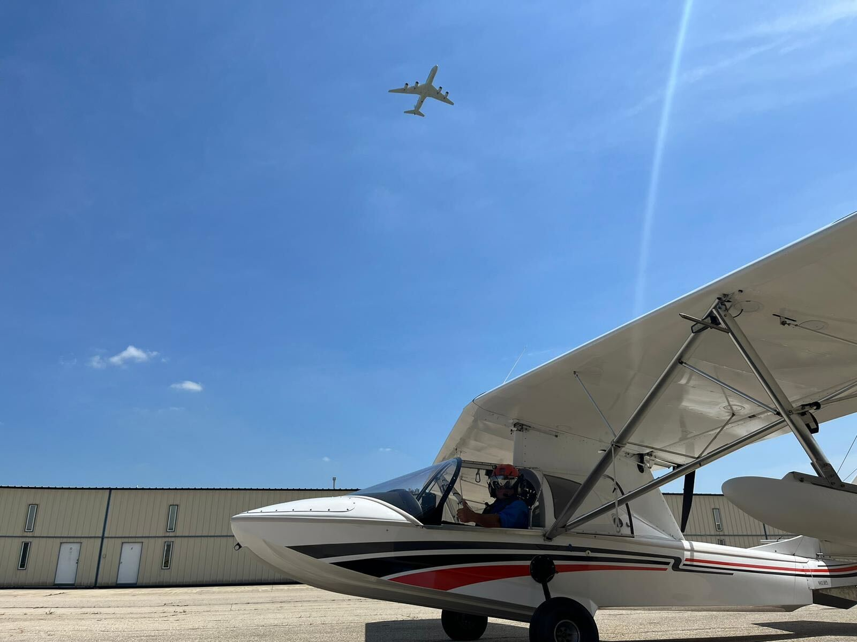
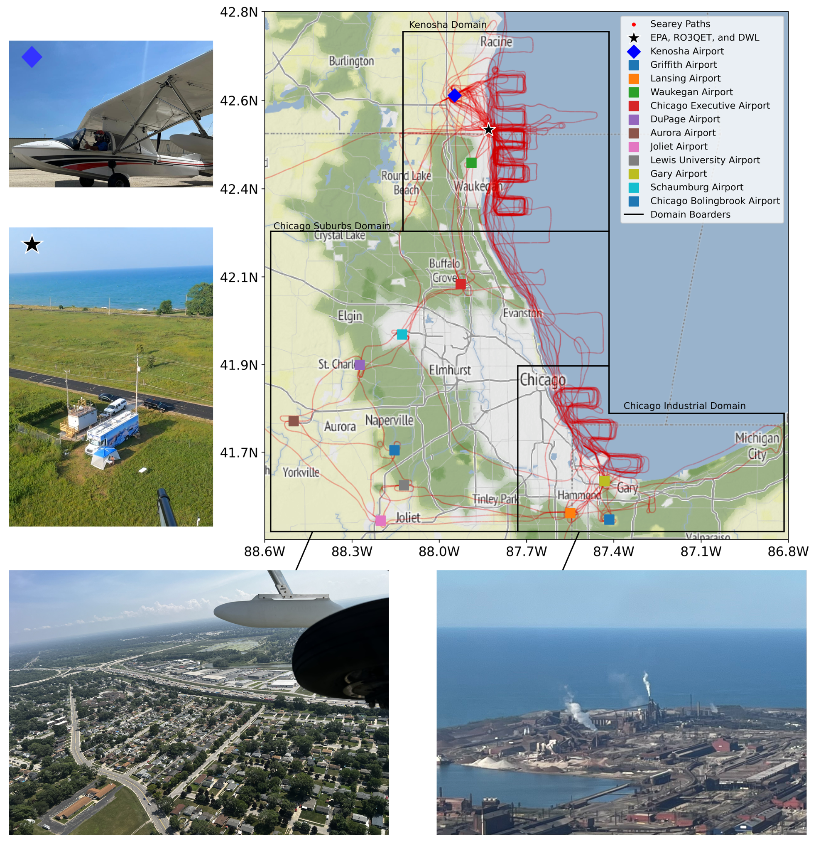
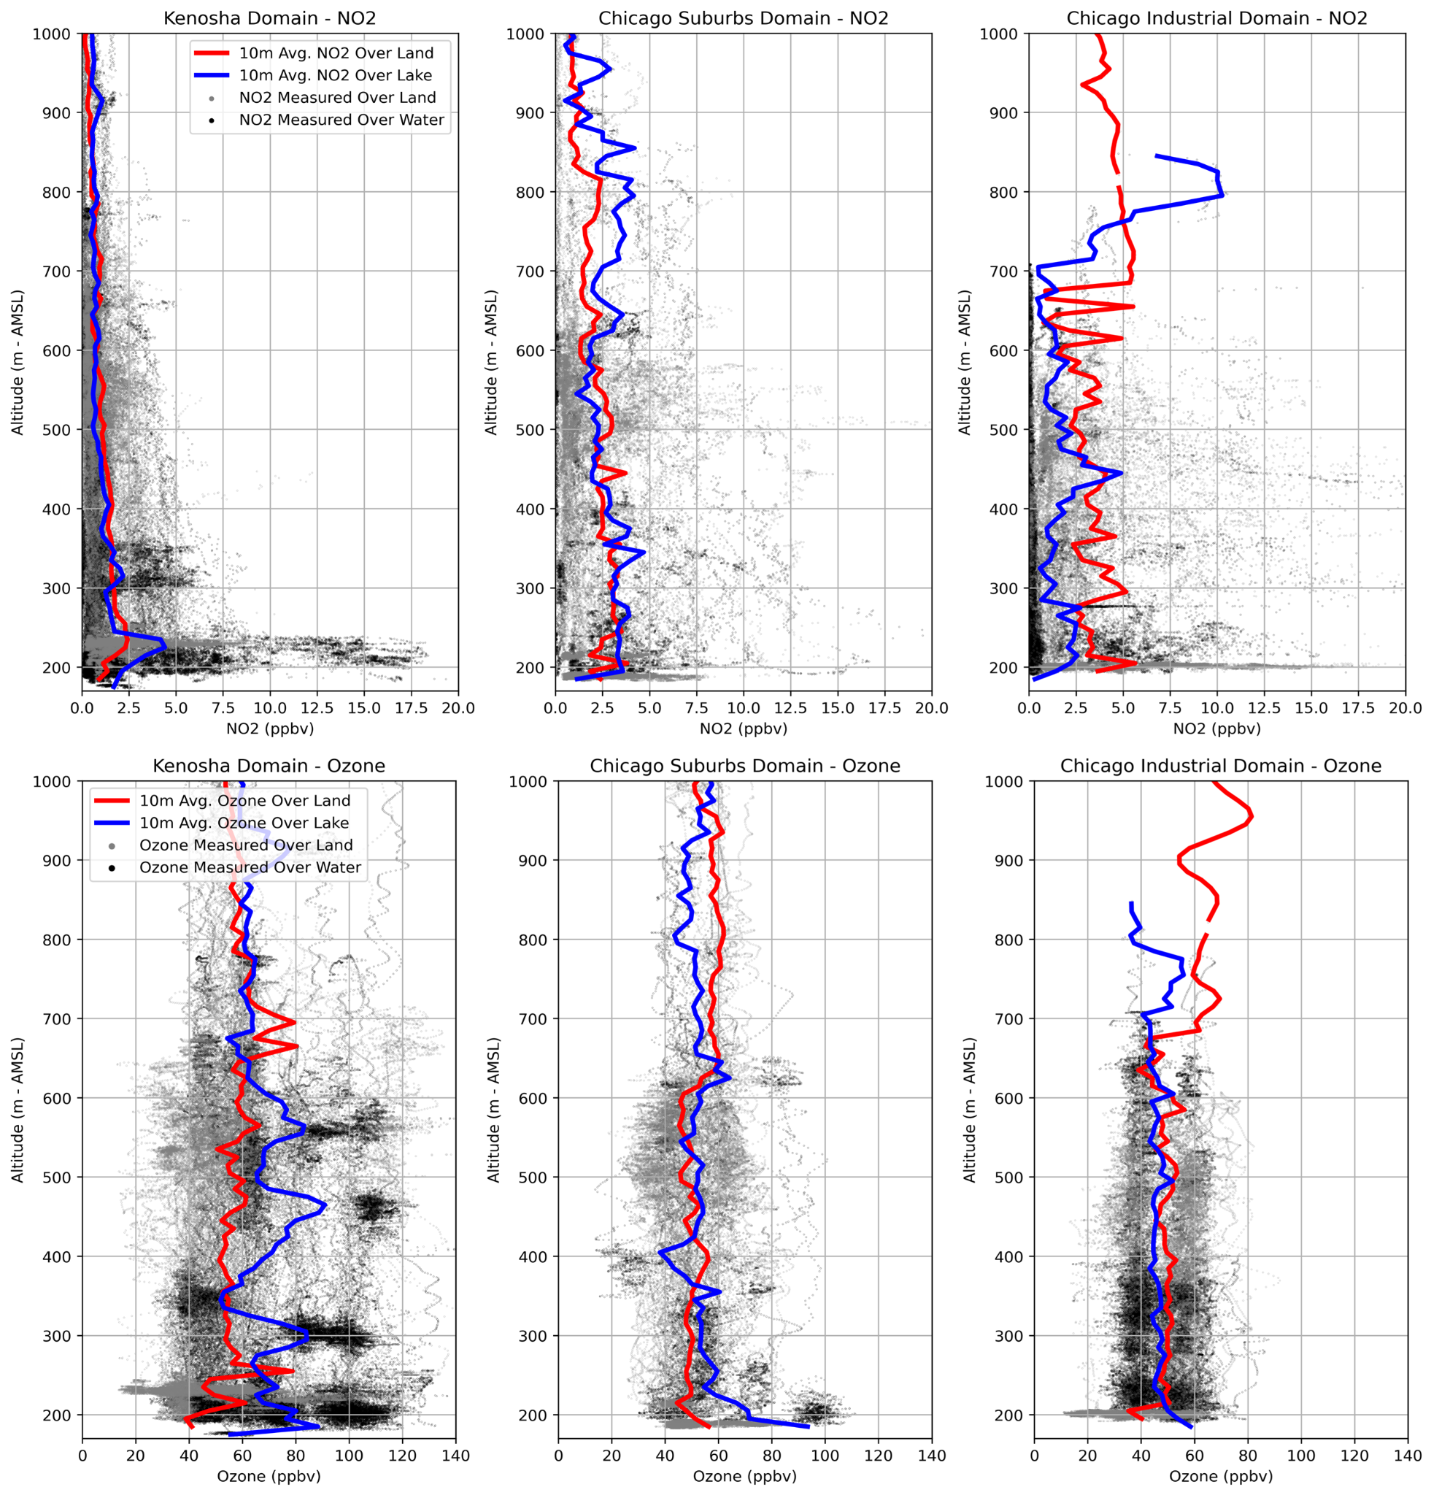

SeaRey Domains and Altitude Distributions of
NO₂ and O₃

Slide 7
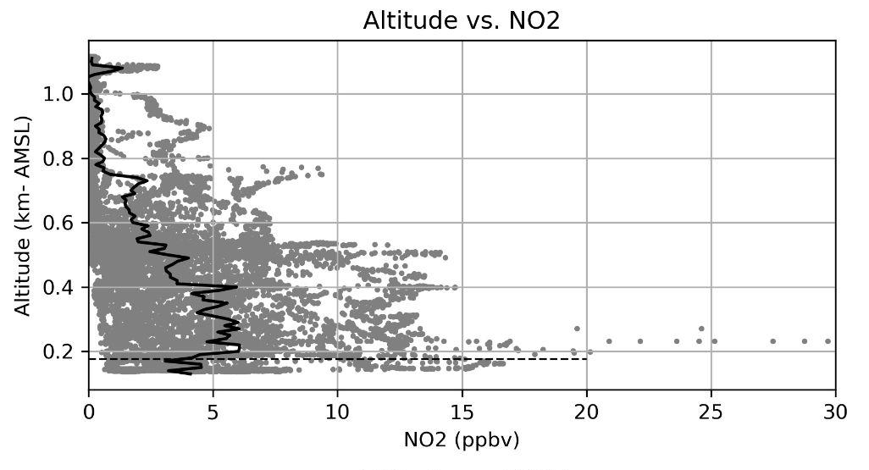
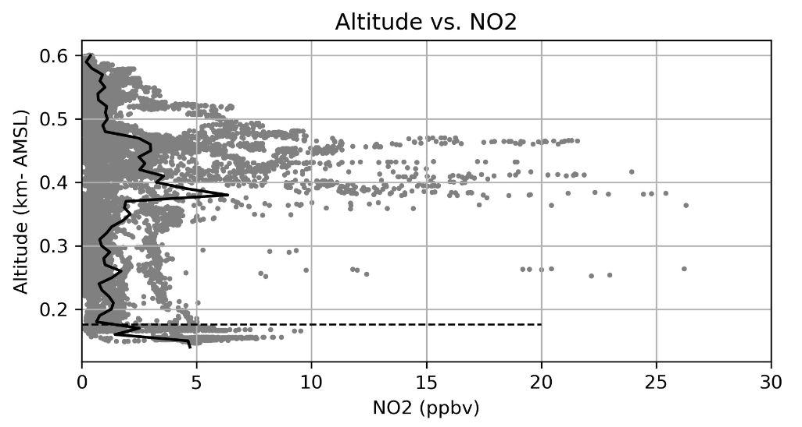
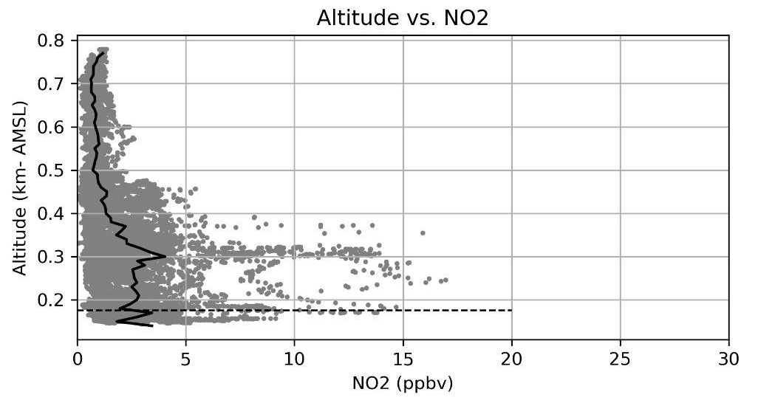
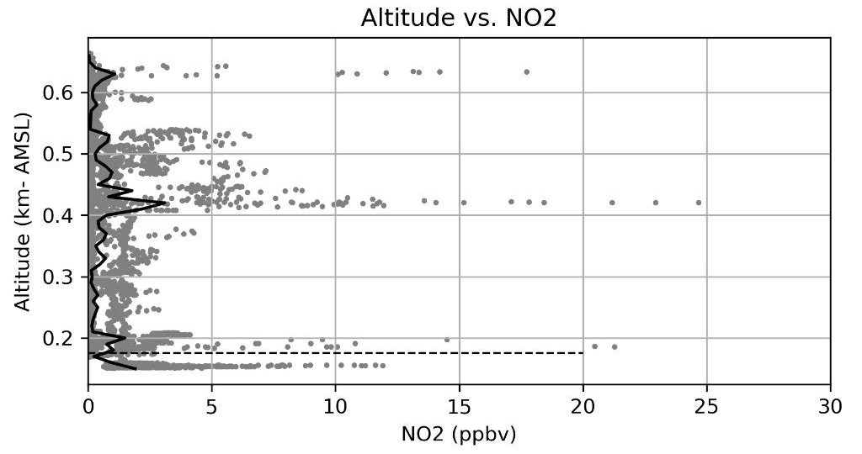
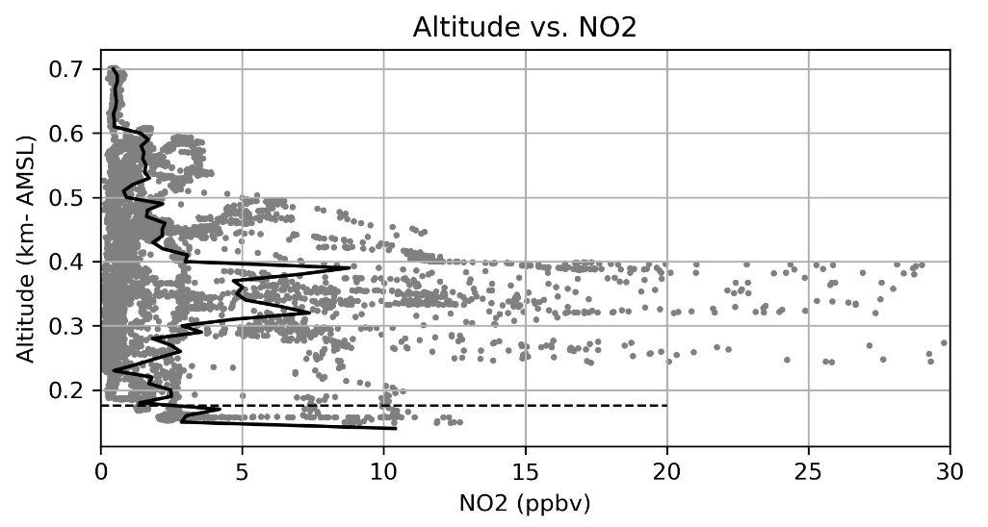
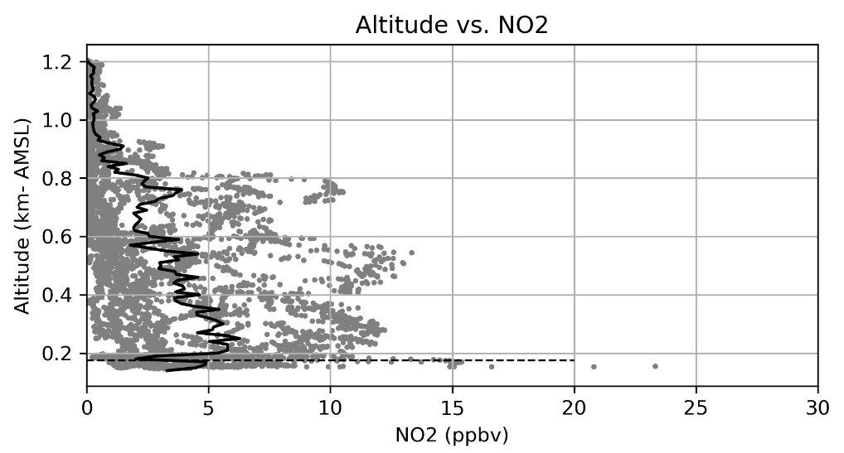
SeaRey Chicago Circuits - NO₂ Profiles over 6 Days
2023-08-09
2023-08-13
Lower PBL NO2 profiles measured by SeaRey do not support the assumption that NO2 decreases exponentially with height.
Elevated levels of NO2, with a higher mixing ratio than at ground level, have been measured at higher altitudes.
Possible aloft plumes that have found a stable equilibrium height?
Thanks to Brad Pierce for predicting the location of the marine NO₂ plumes!
2023-08-10
2023-08-15
2023-08-12
2023-08-16
Left figures: SeaRey profiles of NO2 for flights on 6 different days around the Chicago area.

Slide 8
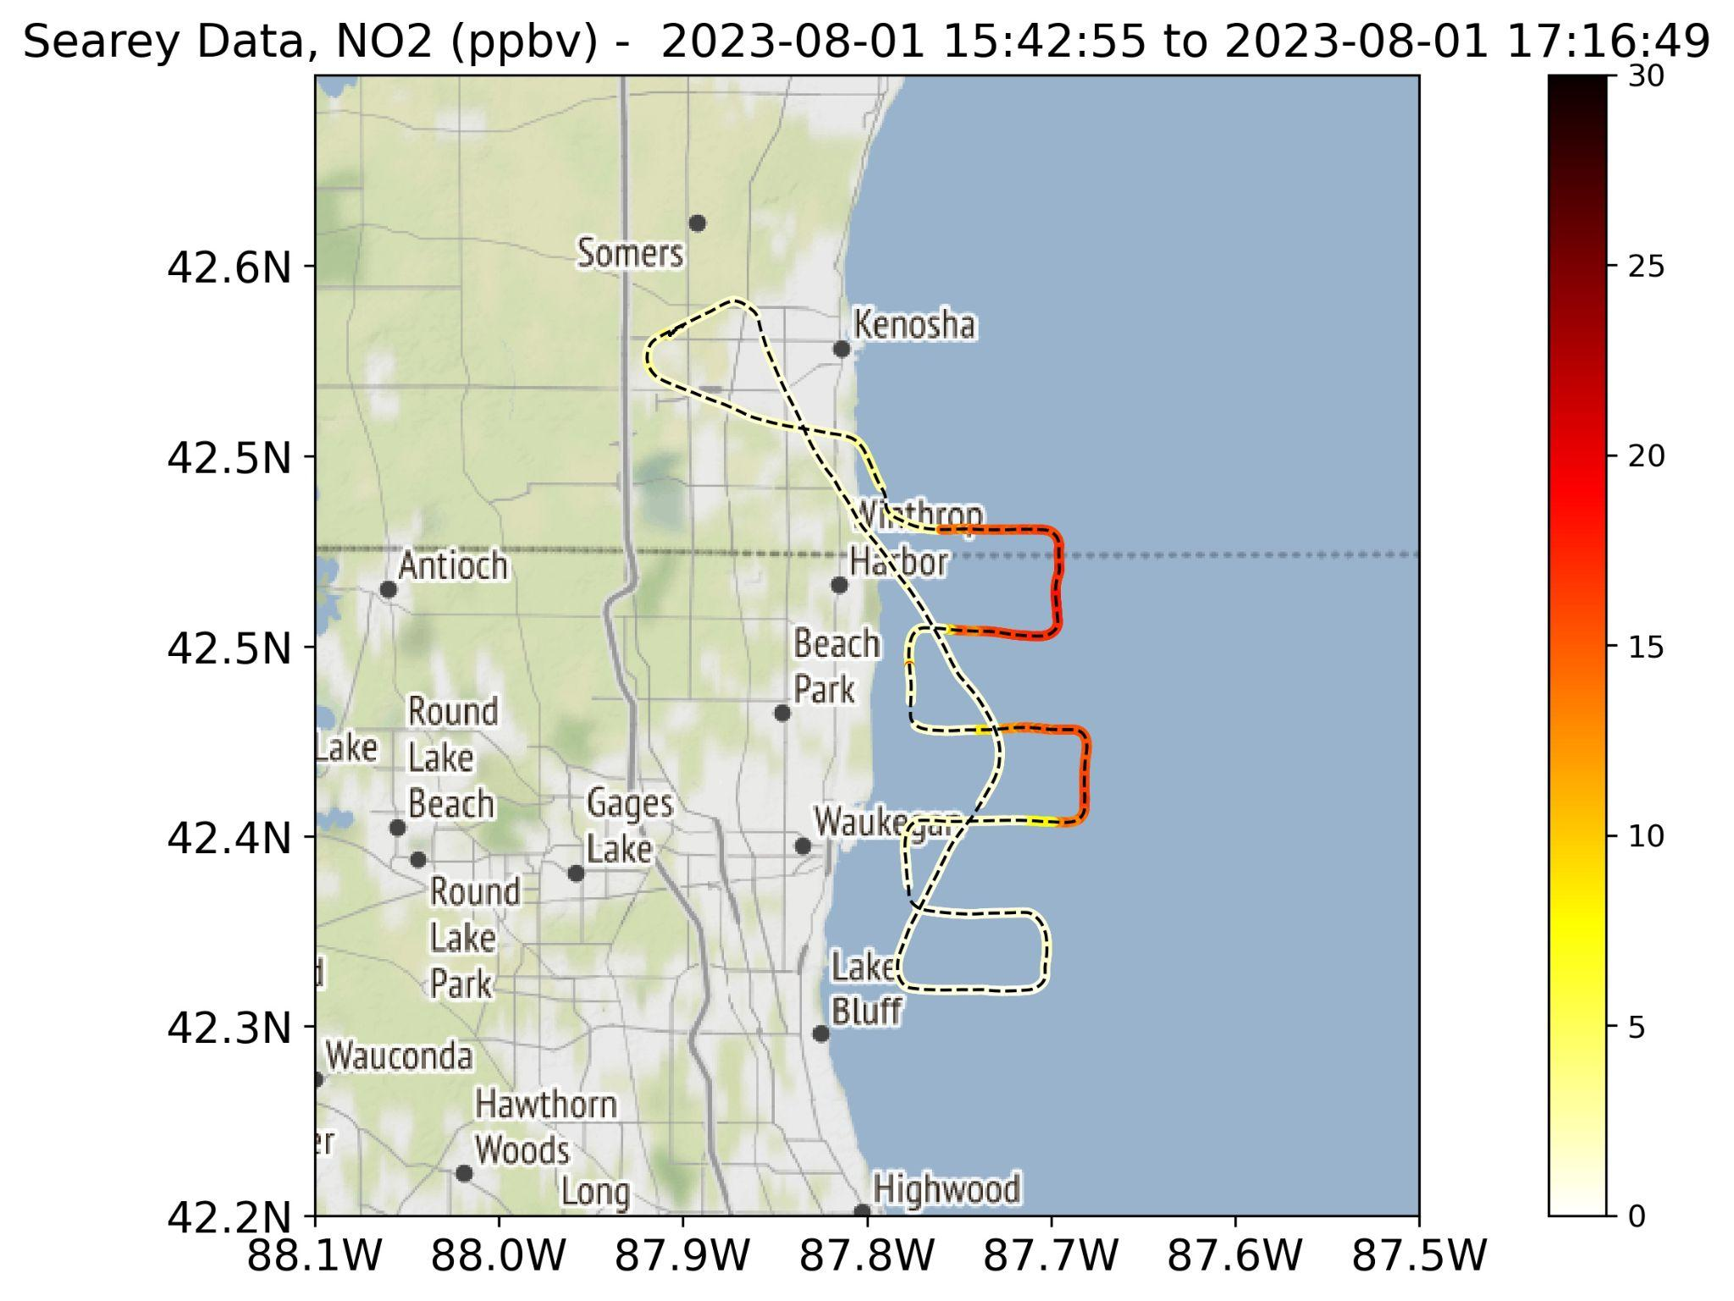
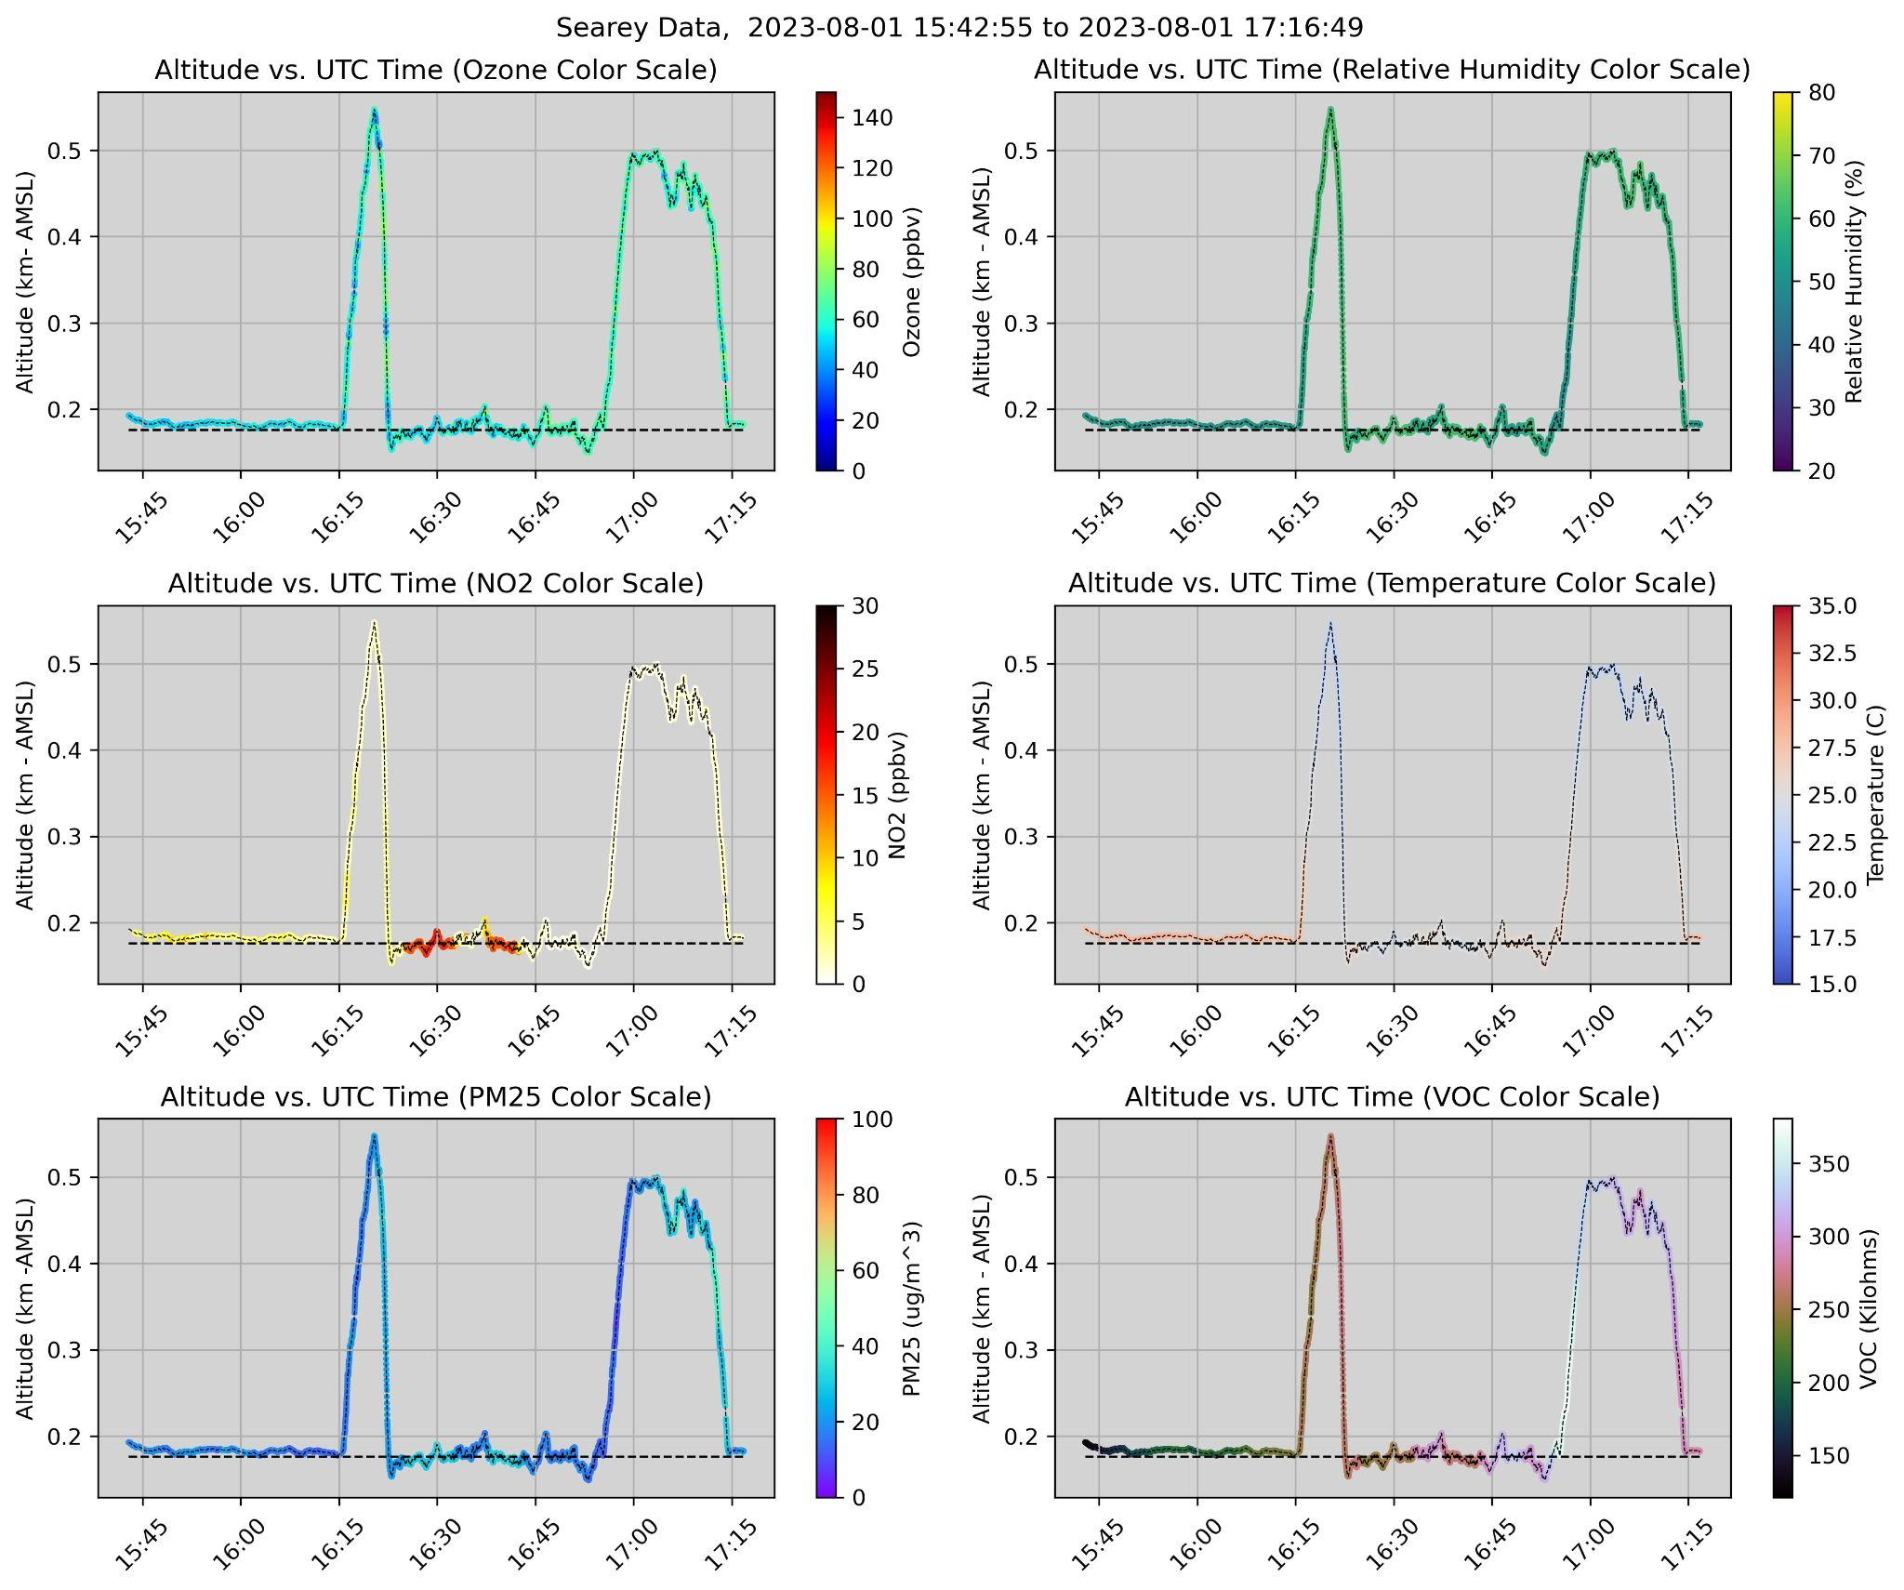
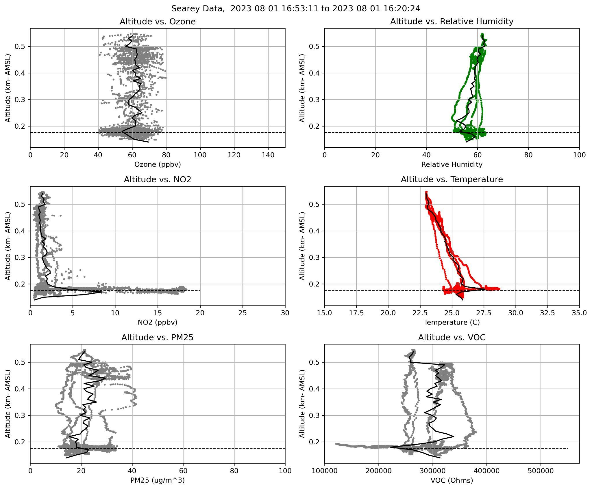
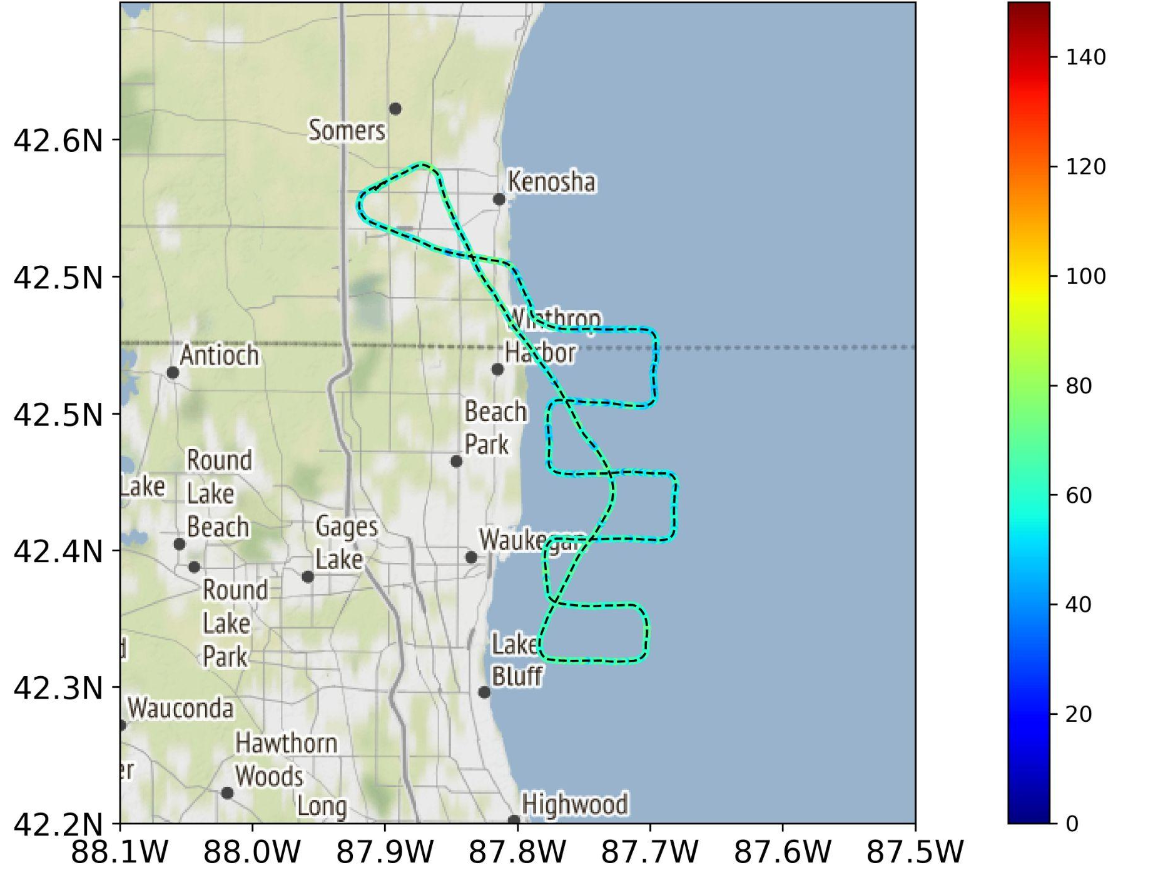
Offshore NO₂ plumes below 30 meters AGL
During exceedance events, the SeaRey aircraft has observed highly concentrated NO₂ plumes occurring 5 - 30 meters above the lake surface.
NO₂
5-30 meters above lake, NO₂: 18 ppbv
TEMPO pixel pattern revealed defined NO₂ plume measured on August 1, 2023.
Ozone
During the early hours of the day, increased NO₂ levels over the lake trigger ozone titration. As the day progresses, high NO₂ concentrations contribute to exceptionally elevated ozone levels, which are then carried onshore by a lake breeze.
All results preliminary

Slide 9

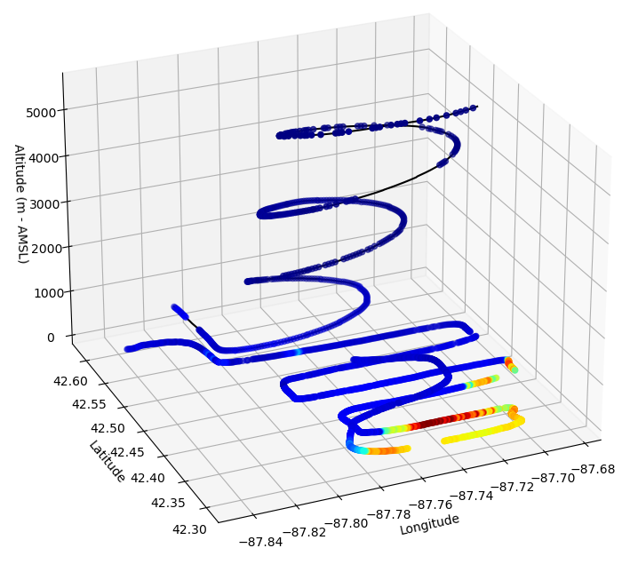
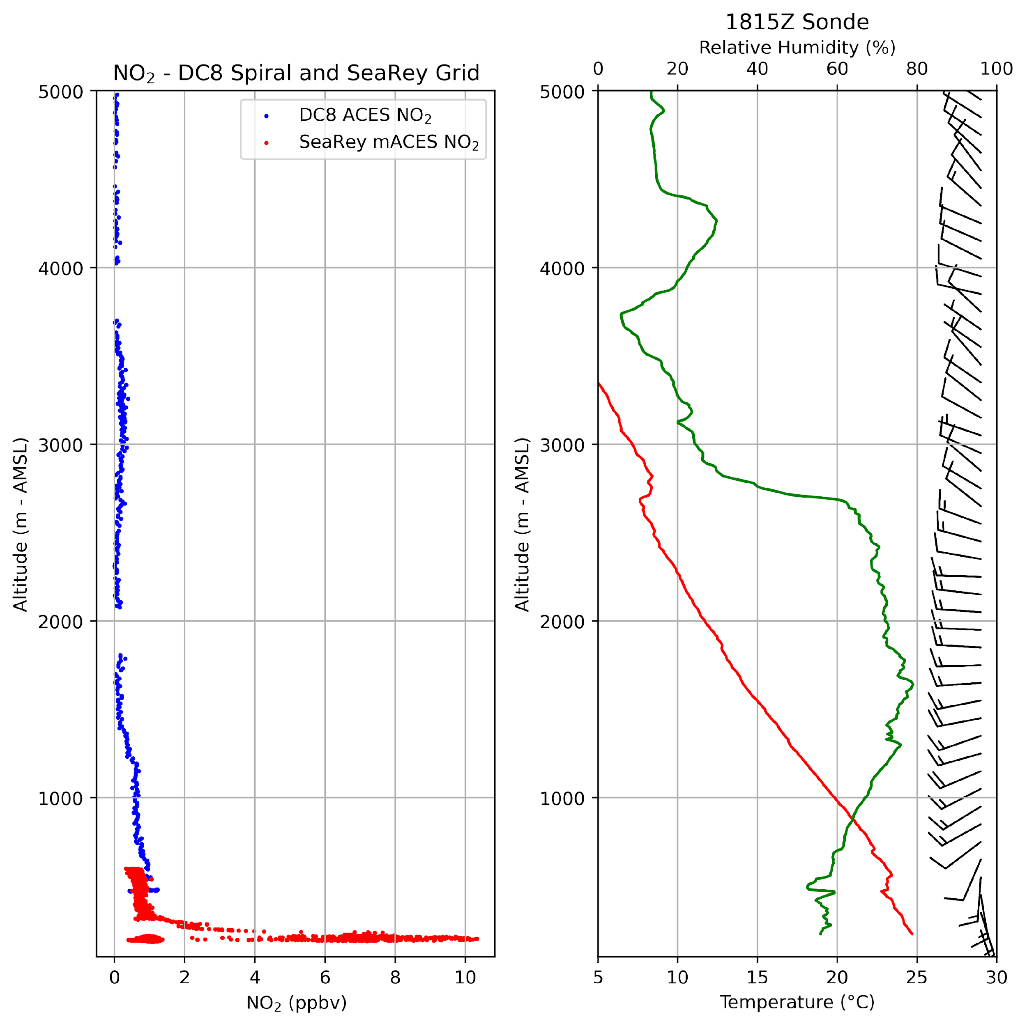
August 1, 2023 – SeaRey and DC-8 NO2 Comparison (CASE 1)
DC8 Spiral
RH
ACES Data Contact:
Caroline Womack
caroline.womack@noaa.gov
SeaRey Grid
T
*SeaRey data paired with DC8 data between 18:20:00 UTC to 18:52:00 UTC
Off the coast of Chiwaukee Prairie
The SeaRey’s ability to fly in the lower marine PBL allowed measurements of constituents not possible due to the altitude limits of large aircraft.
Observe the elevated NO2 levels (10 ppbv) just above the lake (5 – 40 m AGL) during the August 1 flight. The DC-8 was flying too high to measure these marine PBL gradients effectively. These data will be crucial for evaluating TEMPO.
Marine PBL

Slide 10
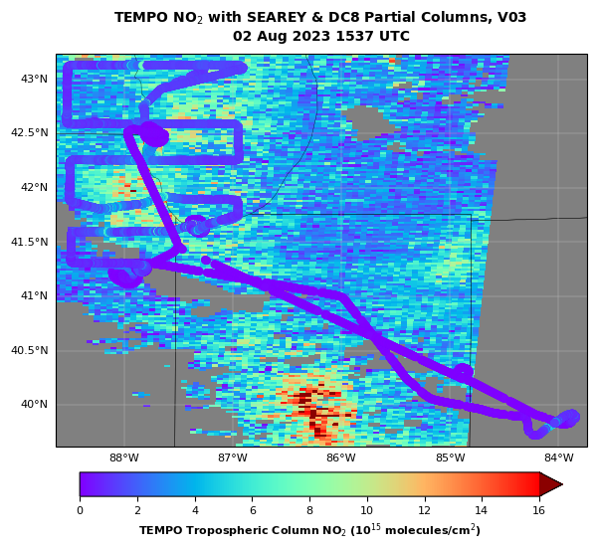
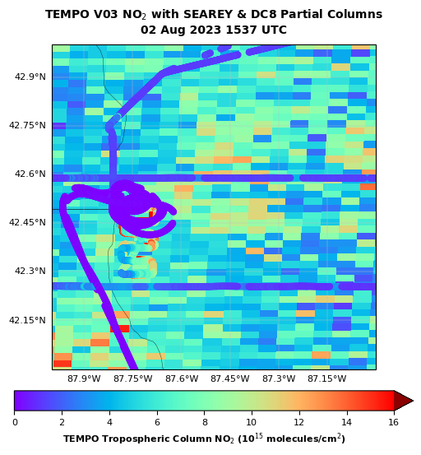
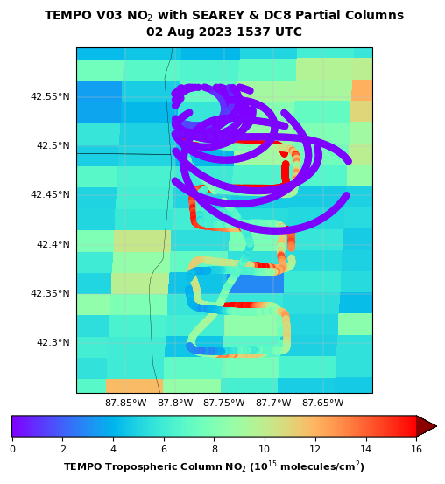
SeaRey and DC-8 NO₂ under TEMPO 8.2.2025

Slide 11
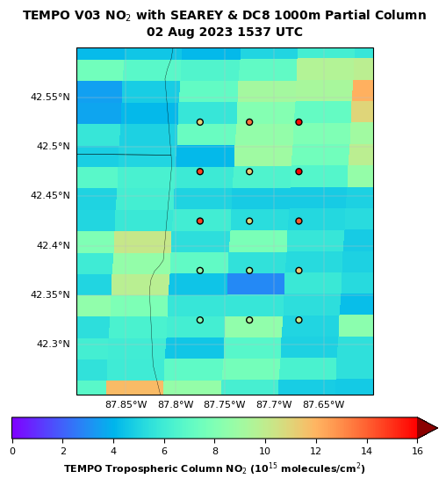

Slide 12
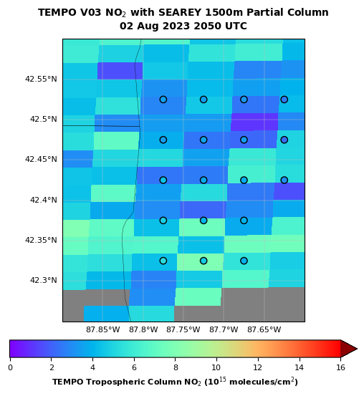
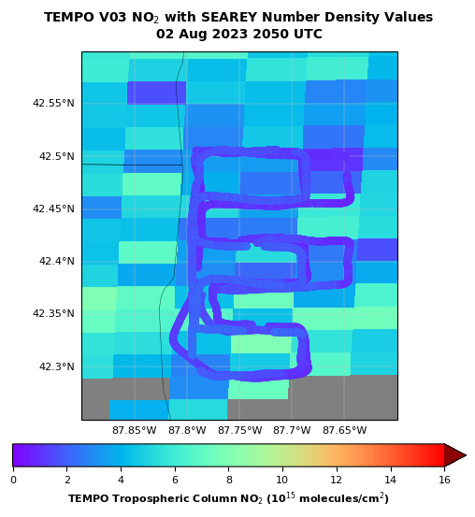

Slide 13
Conclusions
During AEROMMA/LMBREEZE, between July 18 and August 16, 2023, the UAH team successfully collected critical measurements in the Chicago area of the 4-D distributions of ozone, NO2, PM, and meteorology.
The mACES NO₂ instrument demonstrates excellent precision and accuracy.
The lowermost marine boundary layer (5 – 40 m AGL) frequently exhibits the most significant gradients in NO₂ and O_{3.}
These measurements of both the vertical and horizontal distribution of gases and aerosols will contribute to the validation of TEMPO precision and accuracy, especially in the PBL.
These measurements, along with theoretical analyses, contribute to our understanding of the transport and photochemistry of primary pollutants from their respective sources.
May 29, 2024 AGES+ Workshop Boulder, CO

Slide 14


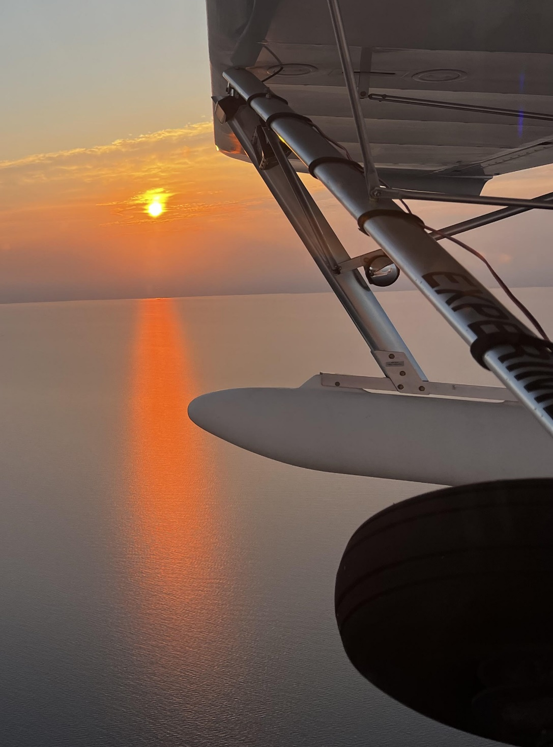
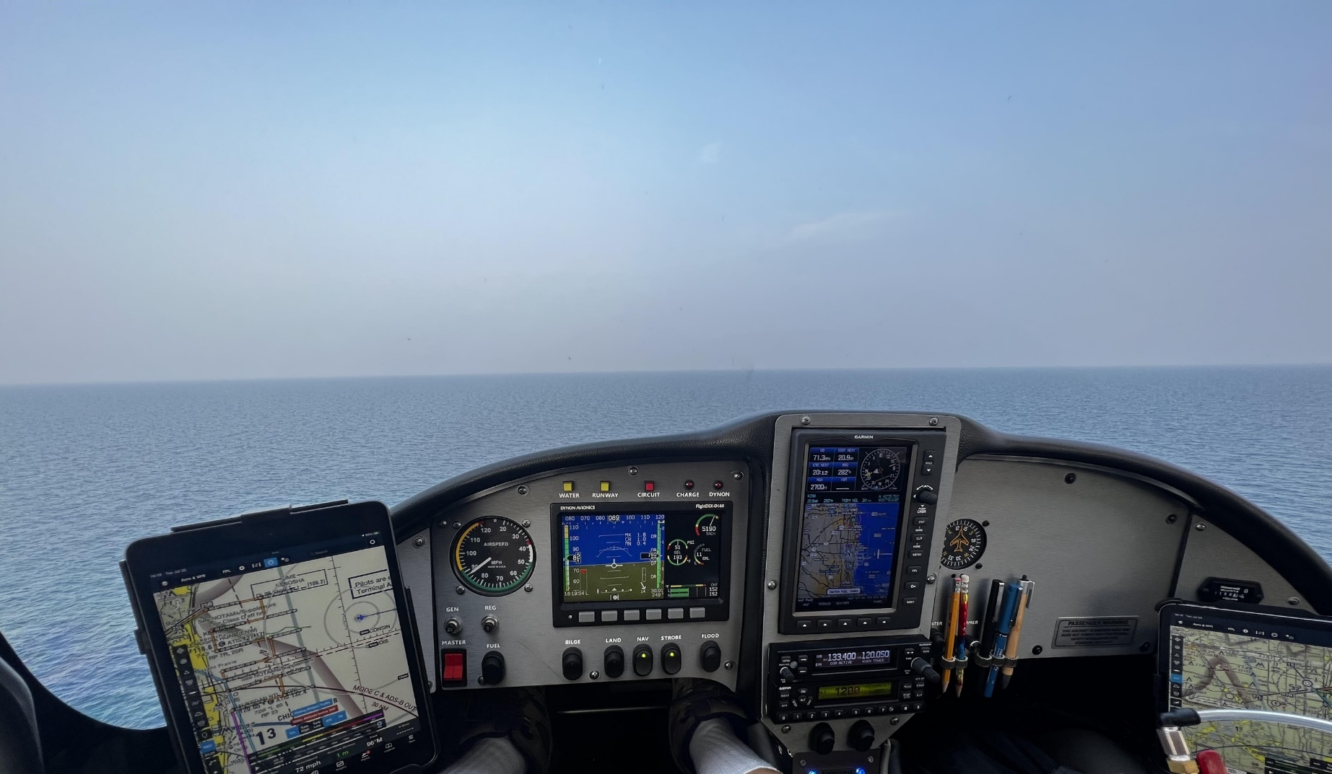
Just Another Day at the Office

